Slide 1
Lecture
Softmax classification:
Multinomial classification

Slide 2
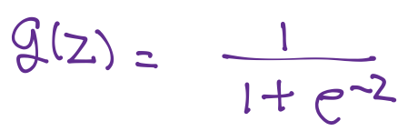
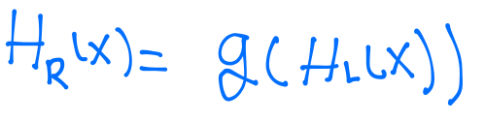
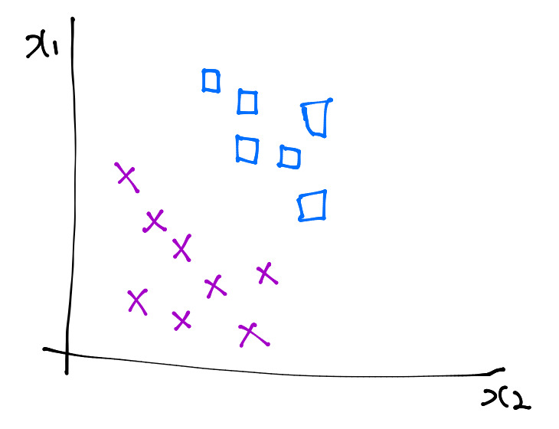
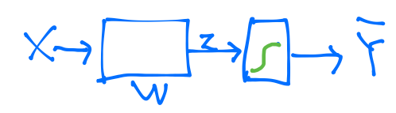
Logistic regression

Slide 3
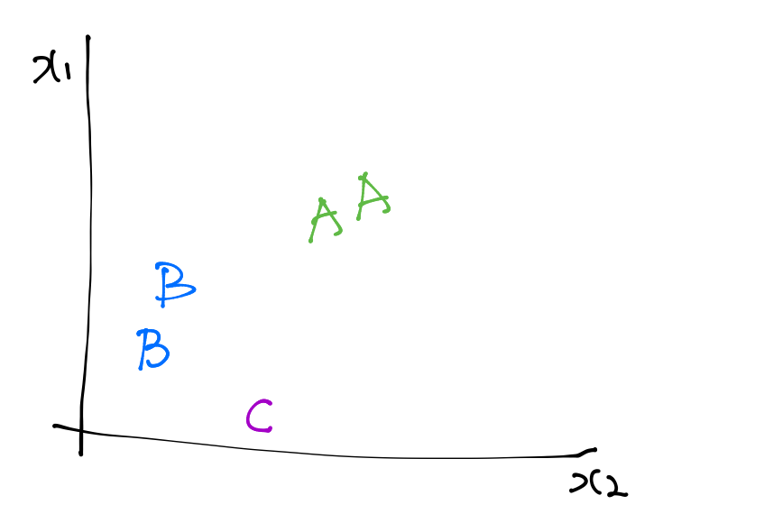
Multinomial classification
x1 (hours) | x2 (attendance) | y (grade)
10 | 5 | A
9 | 5 | A
3 | 2 | B
2 | 4 | B
11 | 1 | C

Slide 4
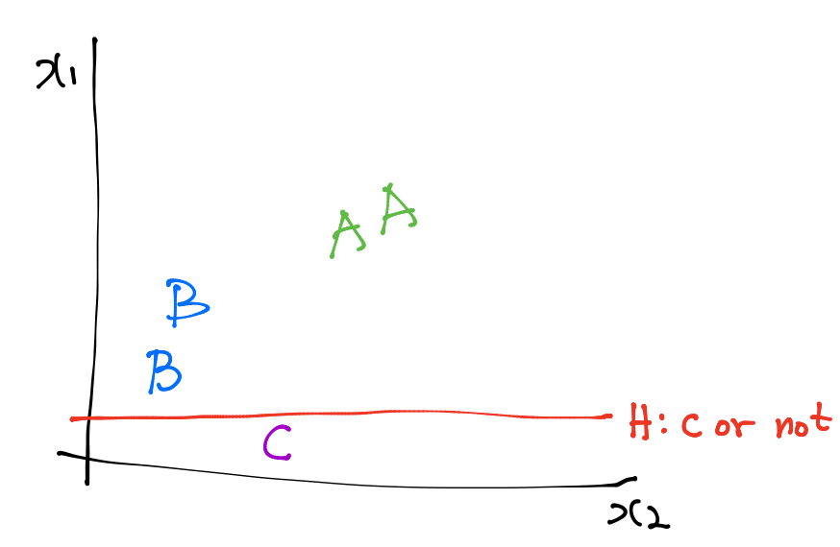
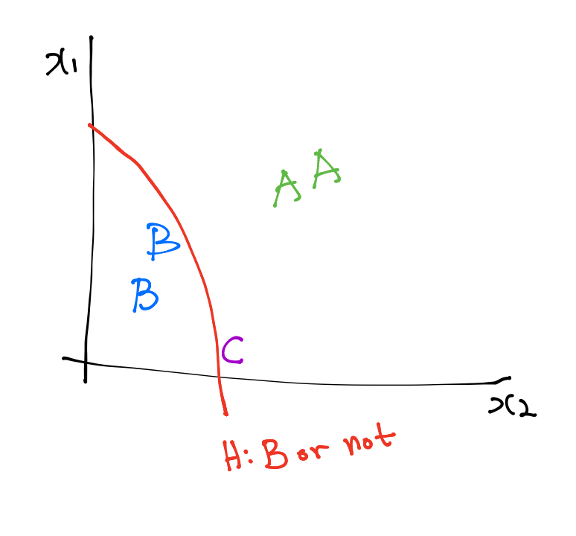
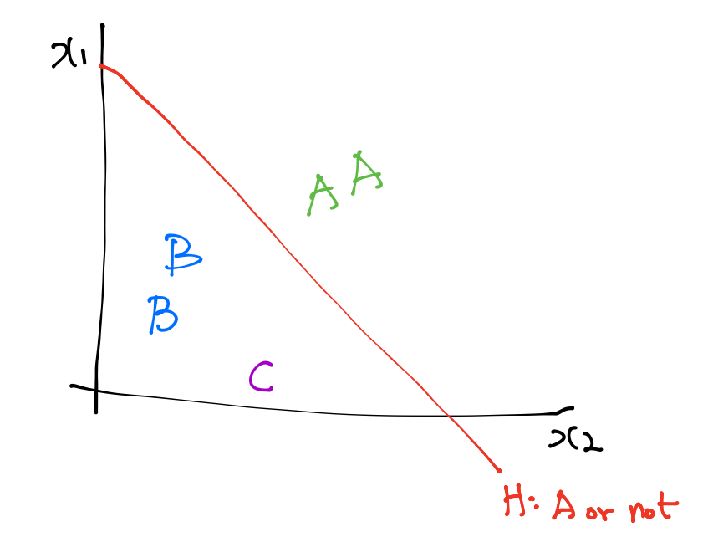
Multinomial classification

Slide 5
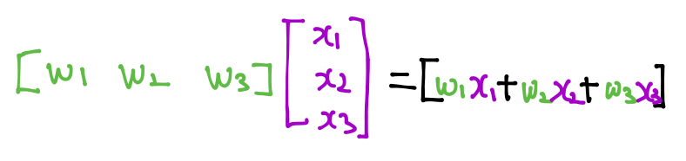
Multinomial classification
A
B
C

Slide 6
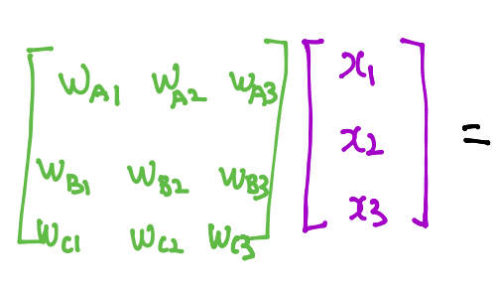
Multinomial classification
A
B
C

Slide 7
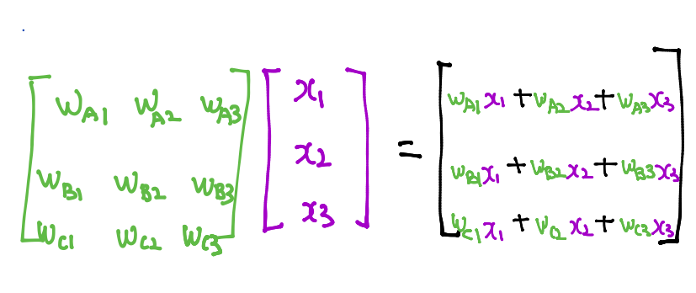
Multinomial classification
A
B
C

Slide 8
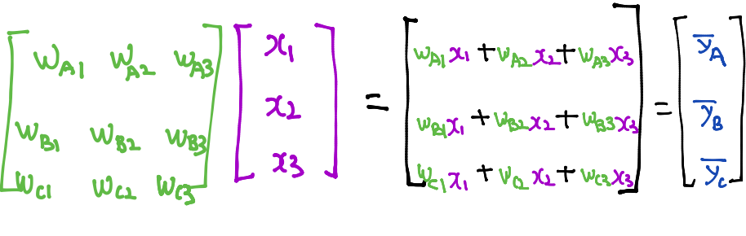
Multinomial classification
A
B
C

Slide 9
Where is sigmoid?
A
B
C

Slide 10
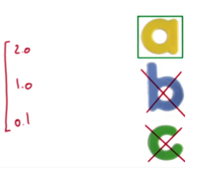
Where is sigmoid?

Slide 11
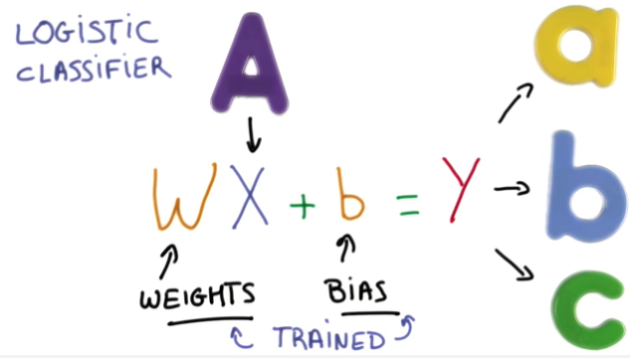

Slide 12
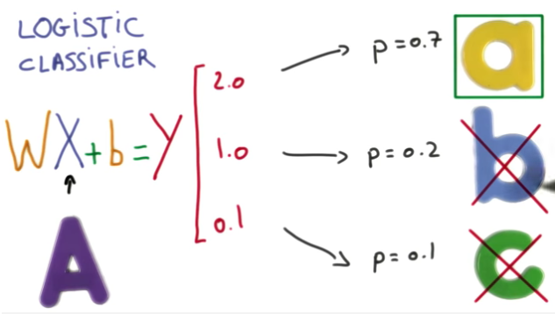
Sigmoid?
https://www.udacity.com/course/viewer#!/c-ud730/l-6370362152/m-6379811817
Notes:
0과 1 사이의 값으로 만들어 주면 좋자나(확률 느낌)? Softmax를 뒤에 붙여주자

Slide 13
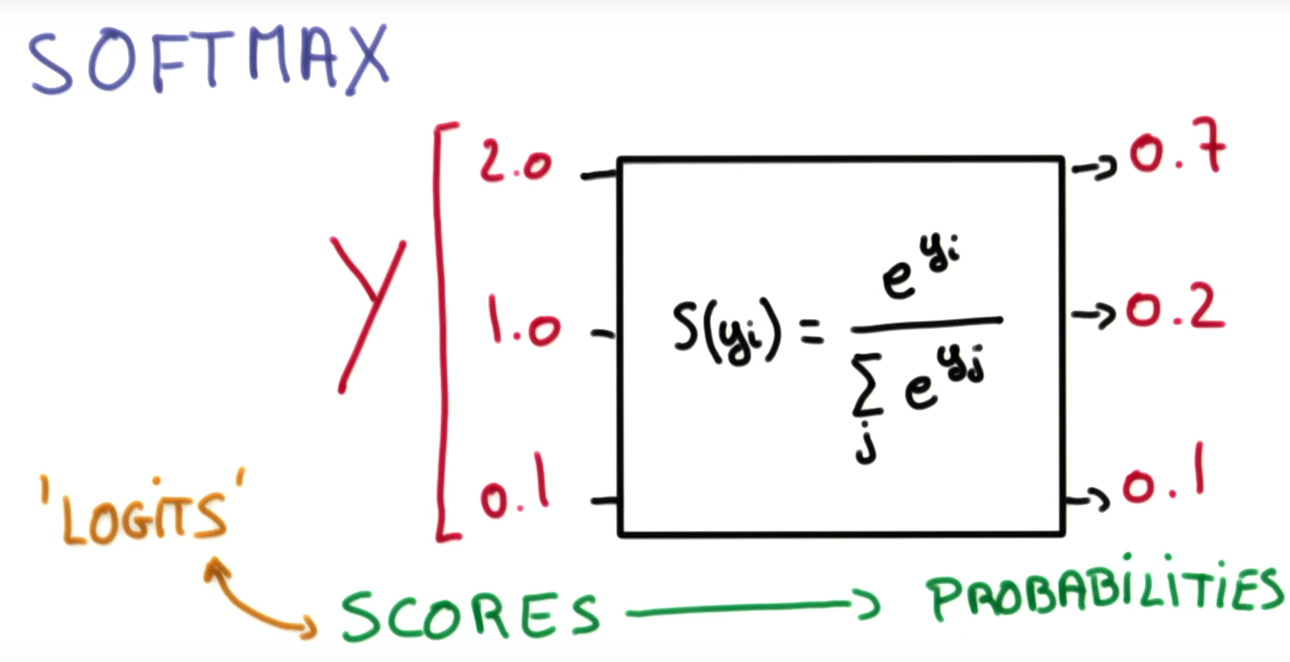
https://www.udacity.com/course/viewer#!/c-ud730/l-6370362152/m-6379811817

Slide 14
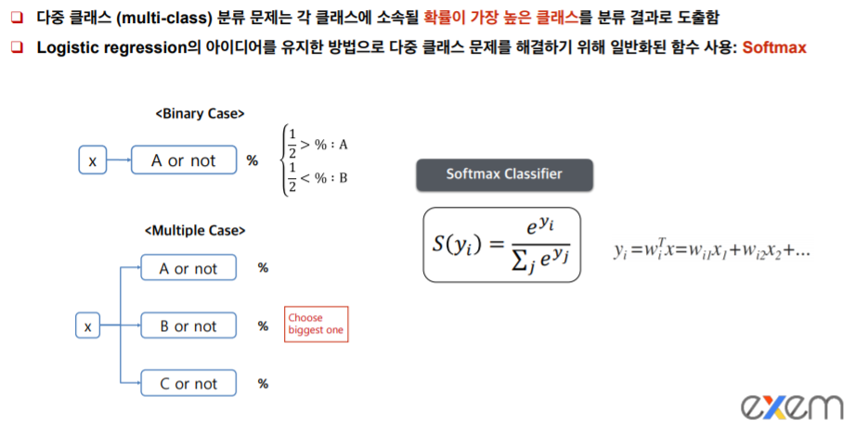

Slide 15
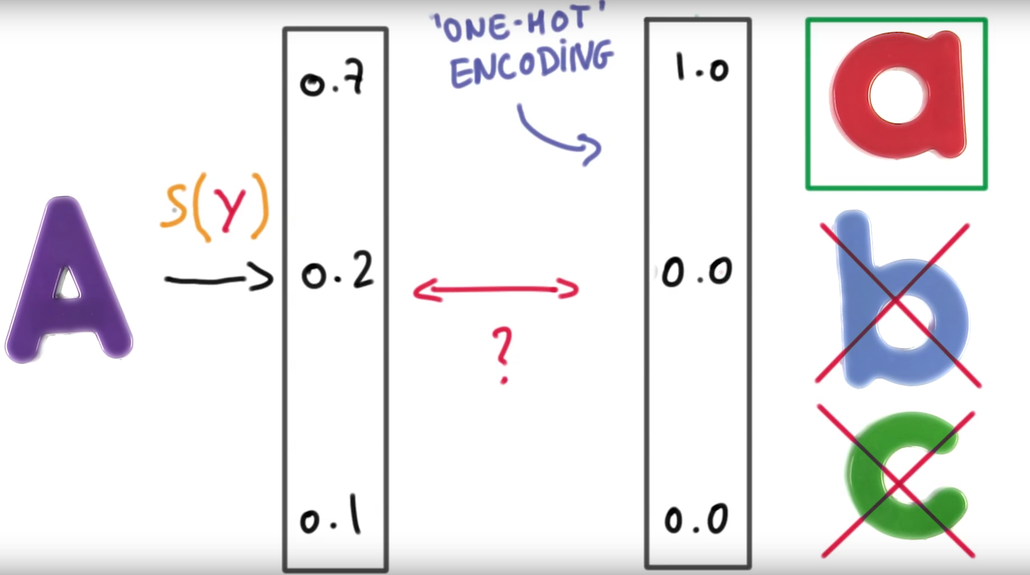
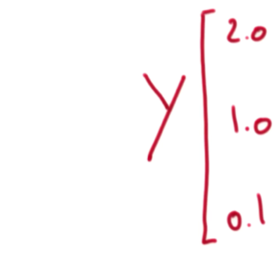
https://www.udacity.com/course/viewer#!/c-ud730/l-6370362152/m-6379811817
Notes:
One hot encoding : Max를 1로 표시해줌

Slide 16
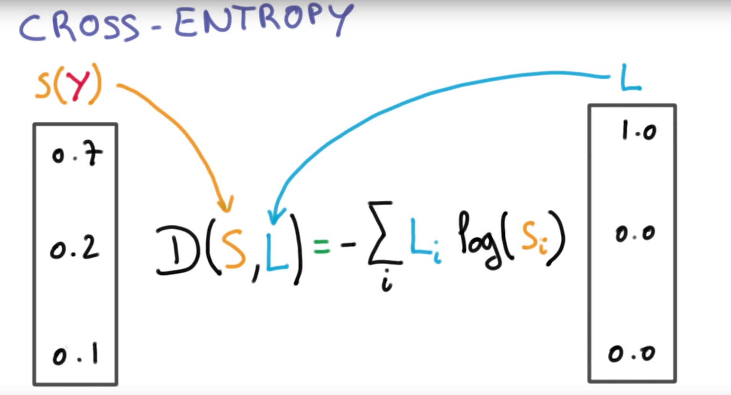
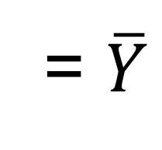
Cost function
= $\overline{Y}$
= Y
https://www.udacity.com/course/viewer#!/c-ud730/l-6370362152/m-6379811817
Notes:
이거의 cost function은 ? Cross entropy를 사용하자.

Slide 17
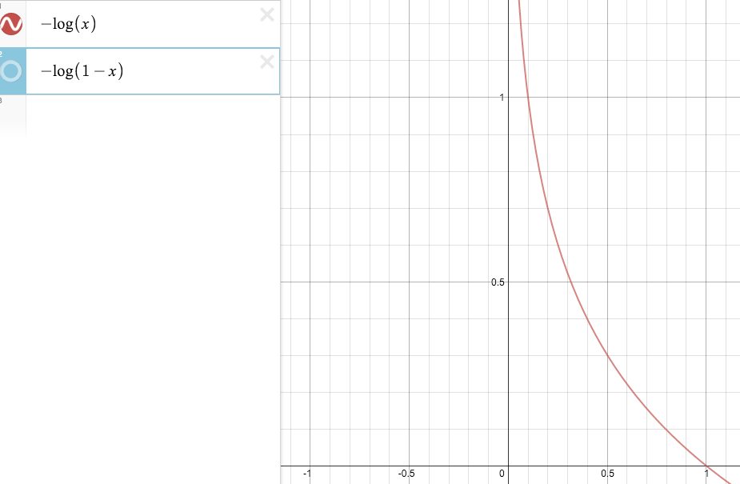
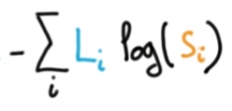
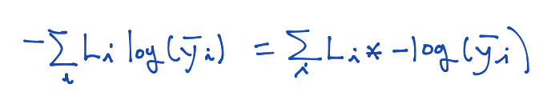
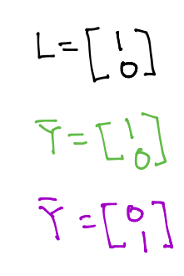
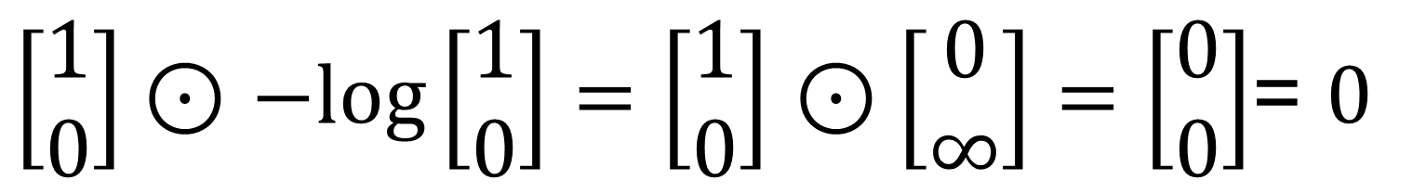
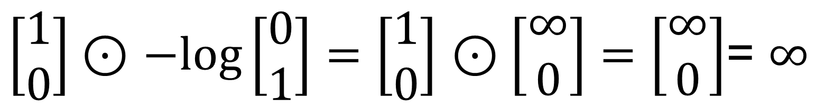
Cross-entropy cost function
= A
$\left[\begin{aligned}1 \\ 0\end{aligned}\right]⊙$ $−log\left[\begin{aligned}1 \\ 0\end{aligned}\right]=\left[\begin{aligned}1 \\ 0\end{aligned}\right]$ $⊙\left[\begin{aligned}0 \\ ∞\end{aligned}\right]=\left[\begin{aligned}0 \\ 0\end{aligned}\right]$= $0$
= A (정답)
$\left[\begin{aligned}1 \\ 0\end{aligned}\right]⊙$ $−log\left[\begin{aligned}0 \\ 1\end{aligned}\right]=\left[\begin{aligned}1 \\ 0\end{aligned}\right]$ $⊙\left[\begin{aligned}∞ \\ 0\end{aligned}\right]=\left[\begin{aligned}∞ \\ 0\end{aligned}\right]$= $∞$
= B (오답)

Slide 18
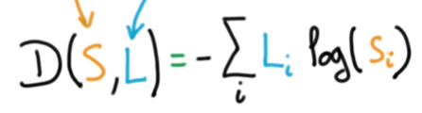
Logistic cost VS cross entropy
c
Logistic cost
Cross entropy

Slide 19
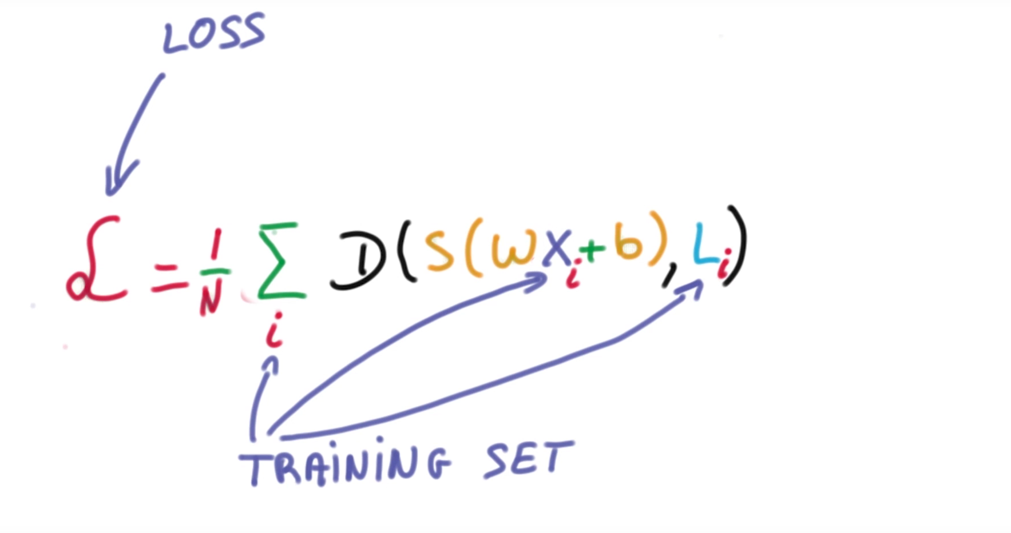
Cost function
https://www.udacity.com/course/viewer#!/c-ud730/l-6370362152/m-6379811817
Notes:
여러 개인 경우 전체 Distance의 평균을 내주면 됨

Slide 20
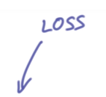
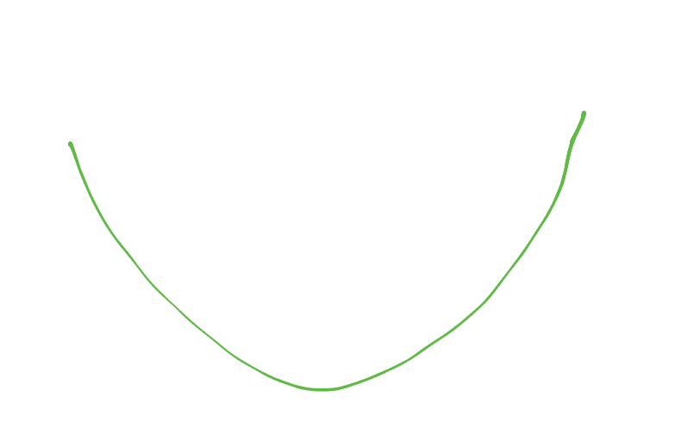
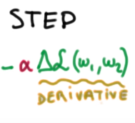
Gradient descent
https://www.udacity.com/course/viewer#!/c-ud730/l-6370362152/m-6379811827
Notes:
이 또한 Convex 형태이기 때문에 어디서 시작해도 최적의 값을 찾을 수 있음

Slide 21
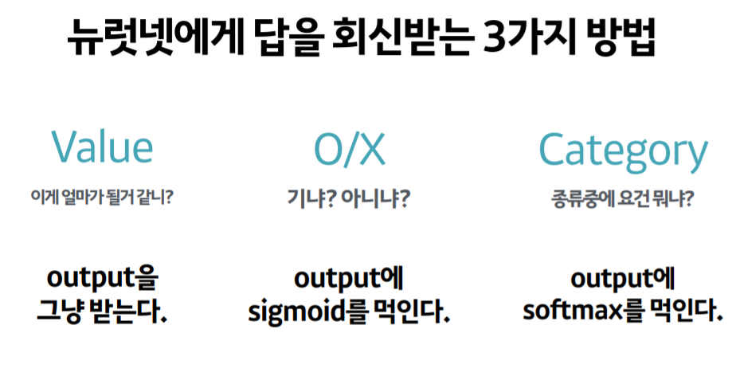
Notes:
Convex 형태이기 때문에 어디서 시작해도 최적의 값을 찾을 수 있음

